Slide 1
Who is Alpha Wealth Funds, LLC
Alpha wealth funds is the manager for The Insiders fund, a long- short equity fund, and a registered investment advisor in the state of Utah .
The Insiders Fund is ranked amongst the best performing long short emerging funds.
Alpha wealth funds provides fee based separately managed accounts based on the 6-step methodology of the CFP. It’s certified financial planning partners complete financial plans and implementation if desired.
As reported by Evestment, Barclay Hedge, and Morningstar

Slide 2
Emerging Alpha
Emerging fund managers are considered funds under a a certain asset level.
Alpha is most likely found in emerging fund managers.
Small funds have many more opportunities to move the needle than giant funds.
Large asset managers and family offices are seeking out alpha

Slide 3
General Partner Harvey Sax
Mr. Sax was SVP at Oppenheimer, Paine Webber, and Assoc Director at Bear Stearns prior to Sax Angle Partners
In addition to his financial acumen, Sax is recognized as a pioneer in the technology field. He is responsible for creating one of the first publicly traded Internet companies.
Mr. Sax holds a B.A from Emory University and a Masters of Security Analysis and Portfolio Management (MSAPM) Creighton University.
Stockbroker, Investment banker, CEO, Harvey has sat at most seats at the investment table. Mr. Sax's view is uniquely shaped by his 360 degree perspective.

Slide 4
General Partner Chase Thomas
Chase is a seasoned financial professional, beginning his
his career in the financial industry at Fidelity Investments. After three years as a Retirement Relationship Manager, Chase was part of team overseeing a half billion of 401(k) assets.
Chase assists in the management of the Fund and specializes in providing financial planning advice to our partners that request it. He is Certified Financial Planner.
A Utah native from Park City and BYU graduate, Chase enjoys skiing, trail running, rock climbing, and the arts with his wife and son.

Slide 5
Executive Summary The Insiders Fund, LP
The Insiders Fund, LP is a long-short equity fund and one of the top performing funds in the country as reported by Barclay Hedge, Evestment, and other independent data vendors.
The Fund was established in February 2010. The founder, Harvey. Sax, has managed money in a substantially identical fashion for over 19 years.
Partnership prefers to trade securities or sectors that have significant insider purchases/sales
Low minimum investments of $250, 000. No lock-ups
Our risk adjusted performance is superior as measured by industry standard Sharpe & Sortino ratios.

Slide 6
Net Returns over Multiple Time Periods
27.30% 2021
14.69% 2020
31.49% 2019
12.42% CAGR since inception
1069.43% Cumulative
Over 626.48% S&P 500

Slide 7
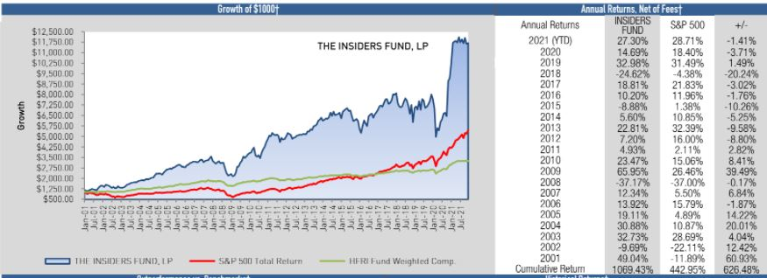
Strategy has Returned 626.48% more than the S&P 500 since Inception
*The performance data prior to Feb 2010 does NOT represents the performance of The Insiders Fund, LP (the "Fund") but instead reflects the performance of personal trading accounts of Harvey Sax. The results reflect the deduction of: (i) an annual asset management fee of 2%, accrued monthly; (ii) a performance allocation of 20%, accrued monthly and taken annually, subject to a high water mark; and (iii) transaction fees and other expenses incurred by Harvey Sax. During the time period shown, the manager used only those investment strategies disclosed in the Fund's Private Placement Memorandum and there were no material market or economic conditions that affected the results portrayed. Performance compared to Barclay Hedge data dated February 2012..

Slide 8
World Class Ranking
The Insiders Fund
was ranked #4 amongst all long-short equity funds in the world for 2019
By BarclayHedge, a leading independent
alternative investment database vendor.

Slide 9
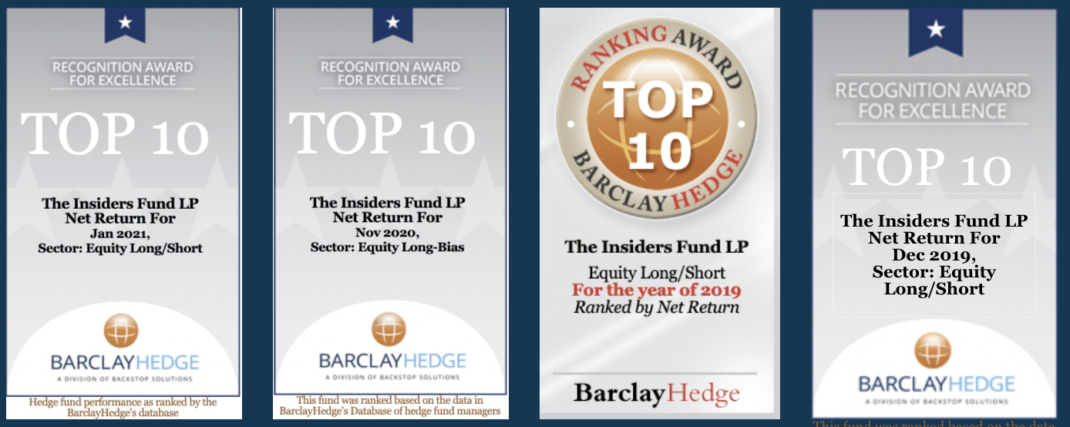
World Class Ranking

Slide 10
World Class Ranking
HSAX PARTNERS (same firm as Sax Angle name change to The Insiders Fund)
was ranked #2 long-short equity fund on trailing 12 month returns and positive returns YTD February 2017
.

Slide 11
Investment Strategy
THE INSIDERS FUND is a long-short equity fund focused on companies with significant insider buying and/or selling.
The same securities are often traded multiple times as opposed to a buy and hold strategy taking advantage of the short swing rule and long -term capital gains when possible.
The Fund views its capital as inventory, seeking to find the equilibrium between the most efficient inventory turnover and maximum return on investment.
Strict risk management rules are adhered to regarding liquidity, diversification, and leverage.

Slide 12
Investment Process
Our process is not to be confused with day trading or momentum trading, as all positions are analyzed from both a fundamental and technical point of view.
We start our due diligence with the understanding that no one knows a business as well as the people running it. Therefore the Partnership prefers to trade securities or sectors that have significant insider purchases/sales, buying and selling the securities at prices and points in time determined by our own proprietary technical analysis.
We spend a great deal of effort and time analyzing insider behavior and exploiting the "short swing rule." We also have developed a proprietary calendar and set of trading tools to exploit significant catalysts.

Slide 13
Exploiting the “short swing rule”
The short swing rule restricts officers and insiders of a company from making short-term profits at the expense of the firm. It's part of United States federal securities law, and is a measure intended to guard against so-called insider trading.
The rule mandates that if an officer, director, or any shareholder holding more than 10% of outstanding shares of a publicly traded company makes a profit on a transaction with respect to the company's stock during a given six month period, that officer, director, or shareholder must pay the difference back to the company.

Slide 14
Insiders have a proven superior investment track record.
Over the last 12 months 2017 we tracked 475 insiders that bought $100,000 or more of their company's stock.
We omitted from this 10% owners as we view them more like hedge funds and not working C-level officers of the Company.
.
We don't look at numbers less than
$200,000 because that can be window dressing, simply execs trying to pump up investor interest.
Average Annualized Insider Return
46.5% vs. 19% for S&P 500

Slide 15
Waves of Insider Buying at Historic Market Bottoms

Slide 16
Comprehensive Review
CHART- Technical set-up, favorable chart pattern for buy/sell decision
ANALYSTS- third party research analysis
INSIDERS- strong emphasis on insider buying more so than selling 4.MANAGEMENT DISCUSSION 10Q AND 10K- review of important SEC filings 5.MARKET DIRECTION- 80% of stocks follow market direction in the short term
6.SECTOR OUTLOOK- buying a good stock in a bad sector can be a humbling experience 7.CASH FLOW- cash flow is more accurate than earnings. Earnings can be more easily manipulated.
8.PEG RATIO- it's good to find a company growing faster than it's multiple. 9.VALUATION- contrary to popular opinion, valuation does matter. Use a discounted cash flow analysis. If the stock is trading for substantially less than its DCF, that's a 1.
10.CATALYST- what's going to change the status quo?

Slide 17
Technical combined with Fundamental Analysis
CEO Grant buys 18,000 at 56.36
Insider buying combined with technical analysis portends immense Monsanto rally 4th quarter 2010.

Slide 18
Proven Methodology
Software designed to exploit inefficiencies in the market like "short swing" rule, overbought/oversold stochastics, RSI divergence, breakout volume, etc.
Our software allows us to monitor hundreds of securities in real time based on technical indicators some of which are proprietary to us.

Slide 19
Portfolio Risk Management
The Fund invests in Level 1 securities exclusively.
Strict diversification guidelines avoid concentrations one sector and in any one security, most investments have material insider buying
Fund may hedge trades with pairs trades, ETF's, futures, and/or derivatives.
Small agile fund may be entirely in cash or short, can change investment posture quickly to meet changing world

Slide 20
Tax Advantages
Favorable tax advantaged strategy. We employ market to market accounting as well as harvesting long term capital gains.
Mark to market accounting provides ordinary busines income with no capital gain carry-forward loss limitations. Losses can offset most ordinary income as well.
Securities identified in a segregated account allow us to be long term capital gain investors.
Alpha Wealth Funds does not provide tax or legal advice. Investors should rely on their tax experts

Slide 21
Financial Results
Monthly performance and shareholder reports supplied by an independent administration firm
Public Accounting Oversight Board certified firm conducts annual audit and prepares partners K-1’s
No lock ups. Investors can withdraw funds at any time 30 day notice or immediately upon the event of death or incapacitation of Principal(s)
Outside counsel has experienced and specialized hedge fund practice
Harvey Sax has a long unblemished background in the securities industry. Harvey Sax was the founder and CEO of a public company.

Slide 22
Fund Structure and Terms
Name of Fund | The Insiders Fund
General Partner | Alpha Wealth Funds
Legal Entity | Limited Partnership
Prime Broker | TradeStation Securities, Inc.
Attorney | The Investment Law Group
Fund Admin | NAV Consulting
Auditor | Berkower LLC
Management Fee | 2.00% Annually
Incentive Allocation | 20% of Profits with High Water
Lock-up | No Lock-up
Redemption Period | Monthly with 30 Days Notice
Minimum Invest | $250,000

